Slide 1
Atliq Hardwares
Resume Project Challenge#4

Slide 2
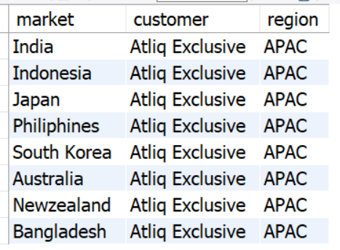
1. Provide the list of markets in which customer "Atliq Exclusive" operates its business in the APAC region.
select distinct market,customer,region from dim_customer
where customer ="Atliq Exclusive" and region ="APAC"
Atliq Exclusive operates in 8 markets
in the APAC region.

Slide 3
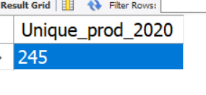
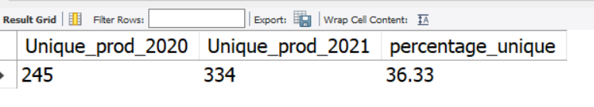
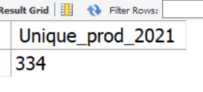
2. What is the percentage of unique product increase in 2021 vs. 2020?
select count(distinct product_code)as Unique_prod_2020 from fact_sales_monthly where fiscal_year=2021;
with prod_20 as(
select count(distinct product_code)as Unique_prod_2020 from fact_sales_monthly
where fiscal_year=2020),
prod_21 as
(select count(distinct product_code)as Unique_prod_2021 from fact_sales_monthly
where fiscal_year=2021)
select Unique_prod_2020,Unique_prod_2021,
round(((Unique_prod_2021 - Unique_prod_2020)/Unique_prod_2020)*100,2)
as percentage_unique
from prod_20,prod_21
select count(distinct product_code)as Unique_prod_2020 from fact_sales_monthly where fiscal_year=2021;

Slide 4
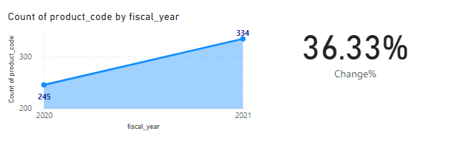
2. What is the percentage of unique product increase in 2021 vs. 2020?

Slide 5
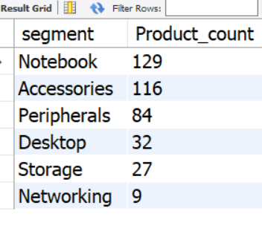
3. Provide a report with all the unique product counts for each segment and sort them in descending order of product counts.
select segment,count(distinct product_code) as Product_count
from dim_product
group by segment order by Product_count desc

Slide 6
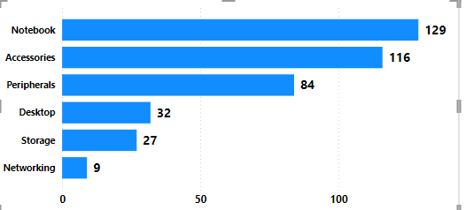

Slide 7
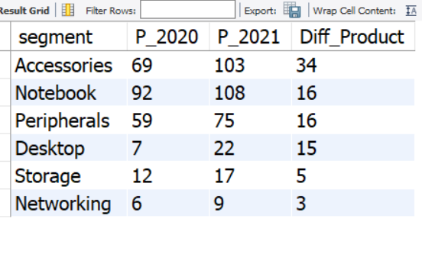
4. Which segment had the most increase in unique products in 2021 vs 2020
with prod_20 as(
select f.fiscal_year ,p.segment,count(distinct f.product_code)
as unique_product
from fact_sales_monthly f join dim_product p
on f.product_code = p.product_code
where f.fiscal_year =2020 group by segment
order by unique_product desc),
prod_21 as(
select f.fiscal_year ,p.segment,count(distinct f.product_code)
as unique_product
from fact_sales_monthly f join dim_product p
on f.product_code = p.product_code
where f.fiscal_year =2021 group by segment
order by unique_product desc)
select a.segment,a.unique_product as P_2020,
b.unique_product as P_2021,
(b.unique_product -a.unique_product) as Diff_Product
from prod_20 as a join prod_21 as b
on a.segment = b.segment order by Diff_Product desc

Slide 8
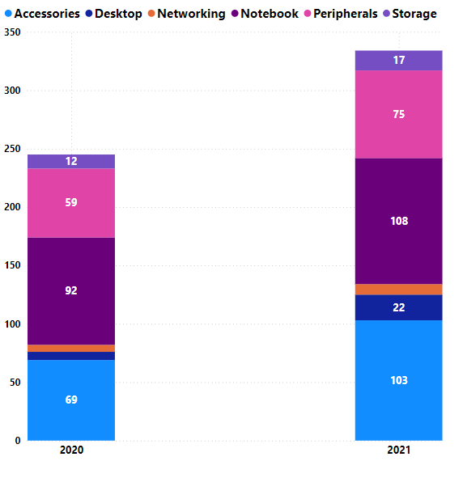
4. Which segment had the most increase in unique products in 2021 vs 2020
Accessories segment has the most increase in unique Products in 2021 compared to 2020 .

Slide 9
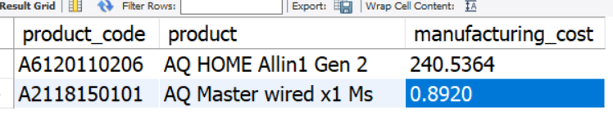
5. Get the products that have the highest and lowest manufacturing costs.
SELECT a.product_code,
b.product,a.manufacturing_cost FROM
fact_manufacturing_cost a
join dim_product b
on a.product_code=b.product_code
where manufacturing_cost =
(select max(manufacturing_cost) from
fact_manufacturing_cost)
union all
SELECT a.product_code,
b.product,a.manufacturing_cost FROM
fact_manufacturing_cost a
join dim_product b
on a.product_code=b.product_code
where manufacturing_cost =
(select min(manufacturing_cost) from fact_manufacturing_cost);

Slide 10
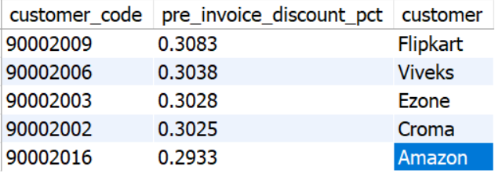
6. Generate a report which contains the top 5 customers who received an average high pre_invoice_discount_pct for the fiscal year 2021 and in the Indian market.
select a.customer_code,a.pre_invoice_discount_pct ,b.customer from fact_pre_invoice_deductions a
join dim_customer b
on a.customer_code =b.customer_code where fiscal_year=2021 and b.market="India" order by a.pre_invoice_discount_pct desc limit 5

Slide 11
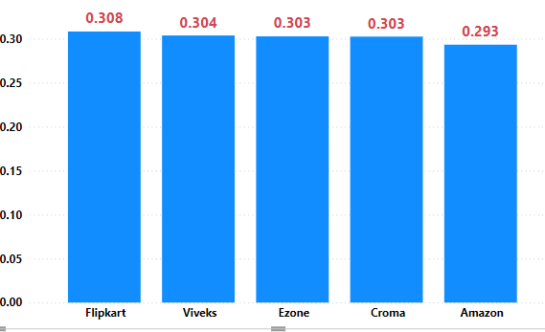
6. Generate a report which contains the top 5 customers who received an average high pre_invoice_discount_pct for the fiscal year 2021 and in the Indian market.
In 2021 and in the Indian market Flipkart received highest pre_invoice_discount_pct.
Viveks,EZone,Croma received almost the same pre_invoice_discount_pct

Slide 12
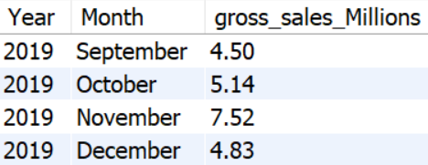
7. Get the complete report of the Gross sales amount for the customer “Atliq Exclusive” for each month.
SELECT year(date) as Year,
monthname(date) as Month,
round(sum(a.sold_quantity *b.gross_price)/1000000,2)
as gross_sales_Millions
FROM fact_sales_monthly a
join fact_gross_price b
on a.product_code = b.product_code and
a.fiscal_year = b.fiscal_year
join dim_customer c
on a.customer_code =c.customer_code
where c.customer ="Atliq Exclusive"
group by Month,Year order by Year

Slide 13
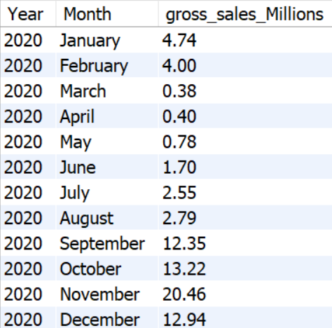
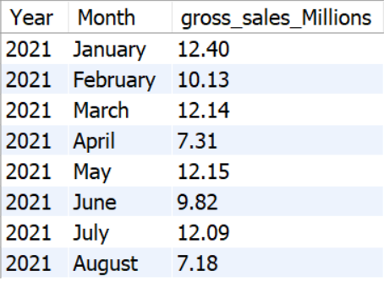

Slide 14
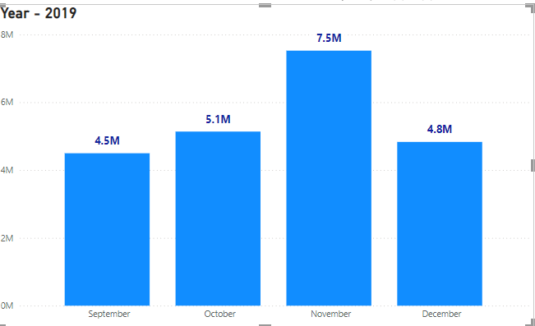
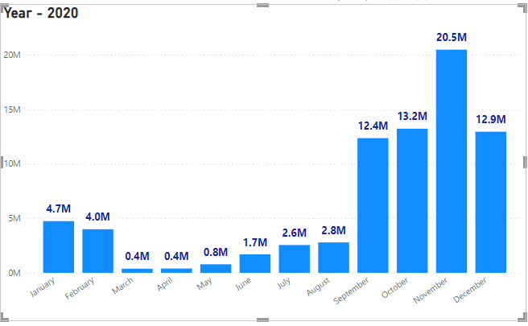
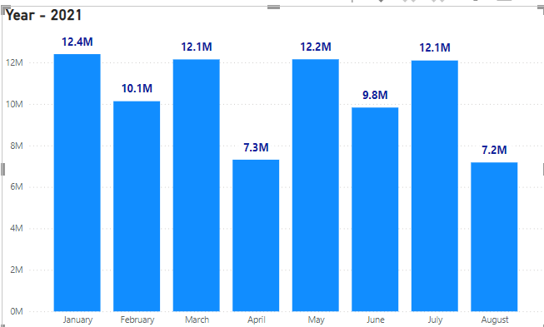
Month November has the highest sales in 2019 & 2020
Month April & August has the lowest sales

Slide 15
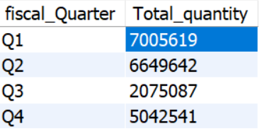
8. In which quarter of 2020, got the maximum total_sold_quantity?
with sales as(
select *, month(date) as month ,
case
when month(date) between 9 and 11 then "Q1"
when month(date) in(12,1,2) then "Q2"
when month(date) between 3 and 5 then "Q3"
when month(date) between 6 and 8 then "Q4"
end fiscal_Quarter
from fact_sales_monthly
where fiscal_year = 2020)
select fiscal_quarter,sum(sold_quantity)
as Total_quantity from sales
group by fiscal_quarter

Slide 16
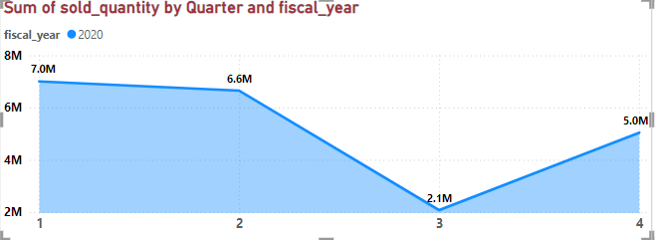
In year 2020
First Quarter has the highest sold quantity
Third Quarter has the lowest sold quantity
The Difference between Quarter 1 and Quarter 3 is around 50000 sold quantity.

Slide 17
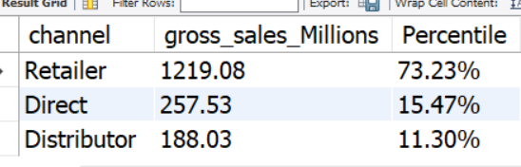
9. Which channel helped to bring more gross sales in the fiscal year 2021 and the percentage of contribution?
with cte1 as(
select a.* ,c.channel,
round(sum(a.sold_quantity *b.gross_price)/1000000,2) as gross_sales_Millions
FROM fact_sales_monthly a
join fact_gross_price b
on a.product_code = b.product_code and a.fiscal_year = b.fiscal_year
join dim_customer c
on a.customer_code = c.customer_code
where a.fiscal_year =2021
group by c.channel)
select channel, gross_sales_Millions,
concat(round(gross_sales_Millions*100/(select sum(gross_sales_Millions) from cte1),2),'%') as Percentile
from cte1
order by Percentile desc

Slide 18
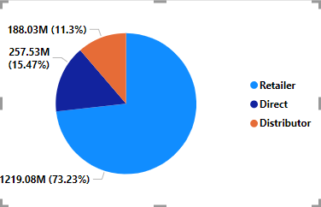
Retailer Channel contributed 73.23% in gross sales of 1219.08 Million
Direct Channel contributed 15.47% in gross sales of 257.53 Million
Distributor Channel contributed 11.30% in gross sales of 188.03 Million

Slide 19
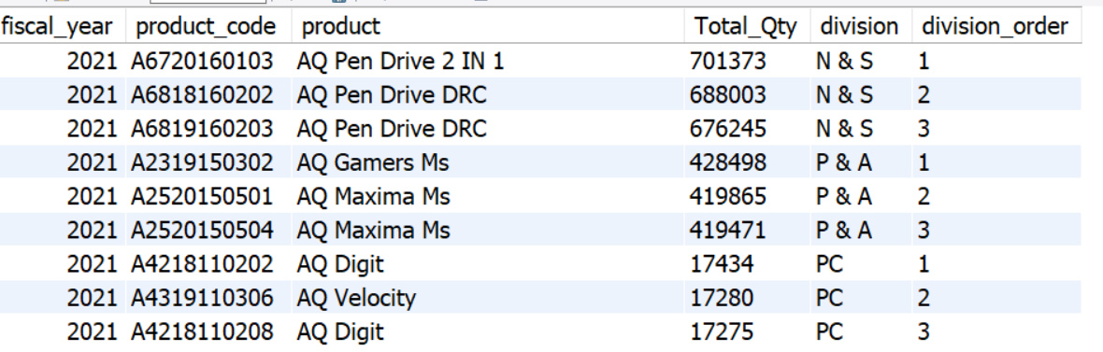
10. Get the Top 3 products in each division that have a high total_sold_quantity in the fiscal_year 2021
with cte1 as(
select a.fiscal_year,a.product_code,b.product,
sum(sold_quantity) as Total_Qty,
b.division
from fact_sales_monthly a
join dim_product b
on a.product_code=b.product_code
where fiscal_year=2021
group by a.product_code),
cte2 as(
select * ,
row_number() over
(partition by division order by Total_Qty desc)
as division_order
from cte1 )
select * from cte2 where division_order<4

Slide 20
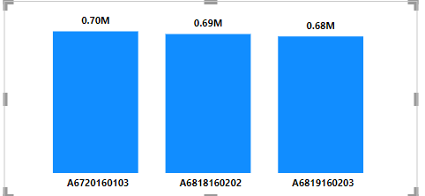
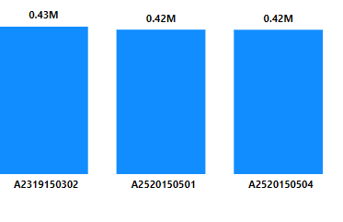
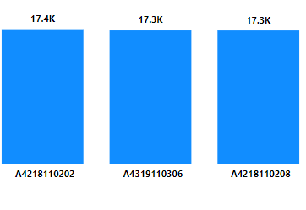
10. Get the Top 3 products in each division that have a high total_sold_quantity in the fiscal_year 2021
N&S P&A PC
Top 3 products by sold quantity in N&S division are “AQ Pen Drive”
Top 3 products by sold quantity in P&A division are “AQ Games” and “AQ Maxima”
Top 3 products by sold quantity in PC division are “AQ Digit” and “AQ Velocity”

